Slide 1
CS 4350: Fundamentals of Software Engineering Lesson 2.1 Three Scales of Design: Introduction
Jonathan Bell, Adeel Bhutta, Ferdinand Vesely, Mitch Wand
Khoury College of Computer Sciences
© 2022 Released under the CC BY-SA license
Notes:
Hi, welcome to Week 2. This week we will concentrate on Design.

Slide 2
Outline of this week’s lessons
Design as a way of communicating
Three Scales of Design
The Architectural Level
The Interaction Scale ("Design Patterns")
The Object Scale (UML, etc.)
Notes:
You and your team will always be making decisions about the design of your project, and you will need a way of communicating those decisions to each other and to others who may have to look at your code.
We will identify three scales of design, which we call the Architectural scale, the interaction scale (corresponding roughly to what are called “design patterns”), and the Object Scale (corresponding roughly to UML or Javadoc).
This week’s material is divided into 4 Lessons: this introductory lesson, and one lesson on each of the three Design Scales.

Slide 3
Learning Goals for this Lesson
At the end of this lesson, you should be able to
explain why design is important
identify three different scales of design
for each of the scales:
be able to give examples of vocabulary words at each scale
Notes:
<read slide>

Slide 4
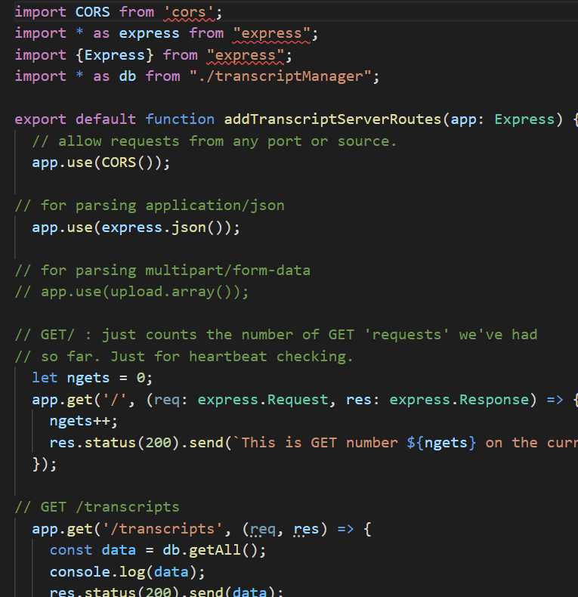
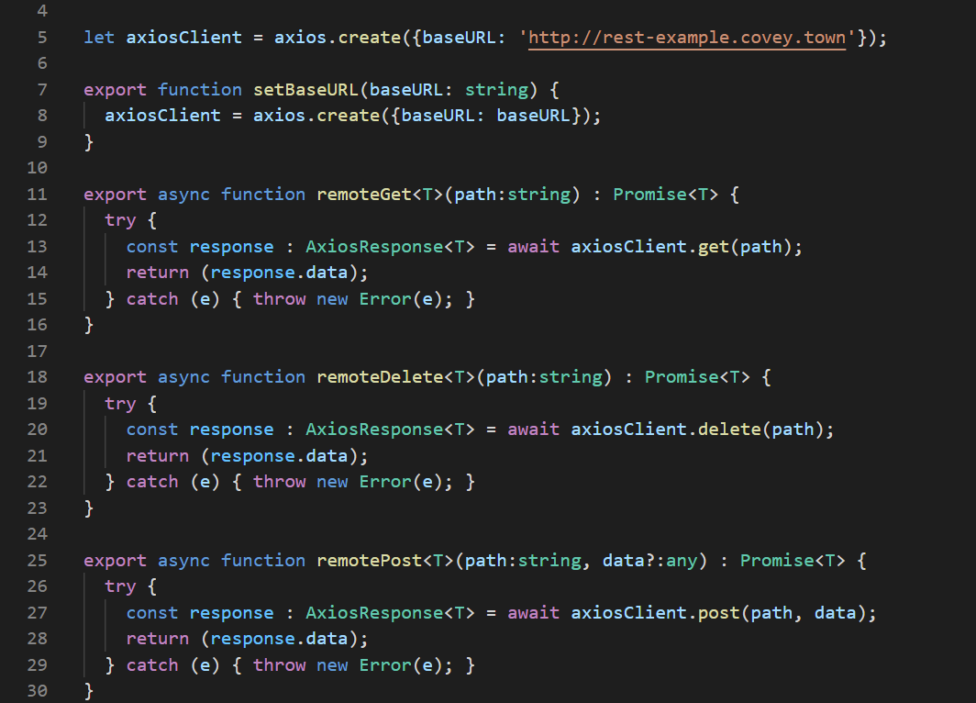
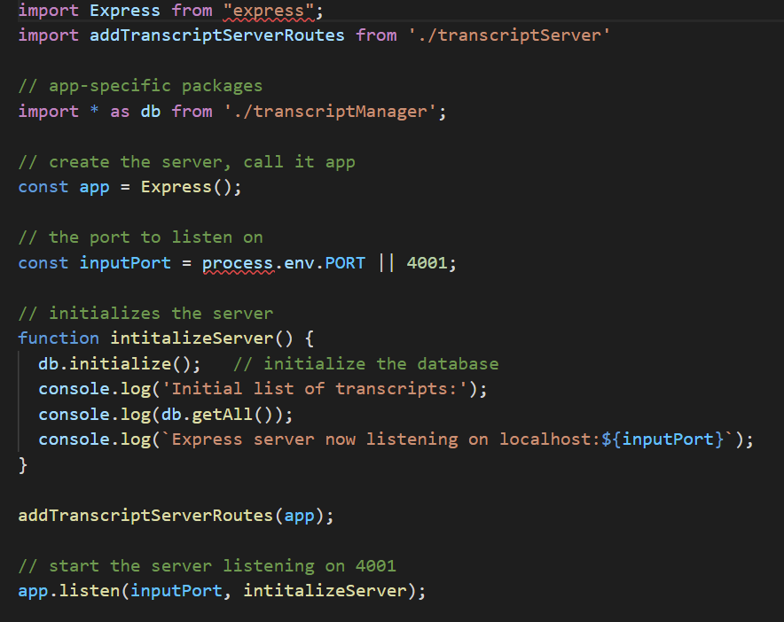
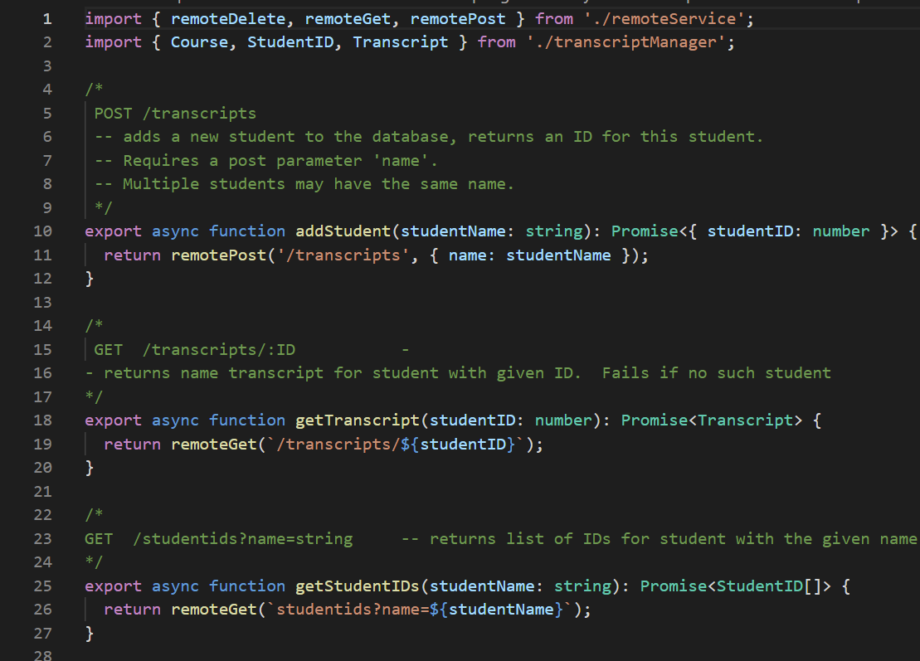
Overall question: How to explain some mass of code
A Design is an Explanation
of what?
for whom?
what gets added to the code?
what gets left out?
Notes:
<click, and watch animation>
The overall question is how to explain this mass of code. But before we can explain, we need to think about what it is we are explaining and who we are explaining it to.
An explanation will probably include information that is not evident from the code itself; similarly, it probably should not include all the details of the code– otherwise the code would be its own explanation.
Let’s take a look at these questions.

Slide 5
Explain to whom?
Software systems must be comprehensible by humans
Which humans?
The other members of your team
The folks who will maintain and modify your system
Management
Your clients
and ...
You, a week from now or 6 weeks from now
5
Notes:
<read slide>

Slide 6
A Design is more than code
Design is about how your code relates to the real world
Design is about the organization of the code
Design is about the relationships between different pieces of the code
So: you need a different language to talk about your design
Remember Principle #2: Make Your Data Mean Something!
Notes:
<read slide>

Slide 7
Communication Requires a Shared Vocabulary
You and your teammates need to have a common understanding of the things in your program.
What are the “things”
What are their names?
What do they represent?
How do they interact?
Notes:
You and your teammates need to have a common understanding of the things In your program. This requires a shared vocabulary.
What are the “things”?
What are their names? (you may get to make up their names. But of course they should be Good Names– that was in General Principle #1 in last week’s lecture)
What do they represent? (that was General Principle #2: Make your data mean something)
How do they interact? There are standard names for many of these interactions. These are called “Design Patterns”.

Slide 8
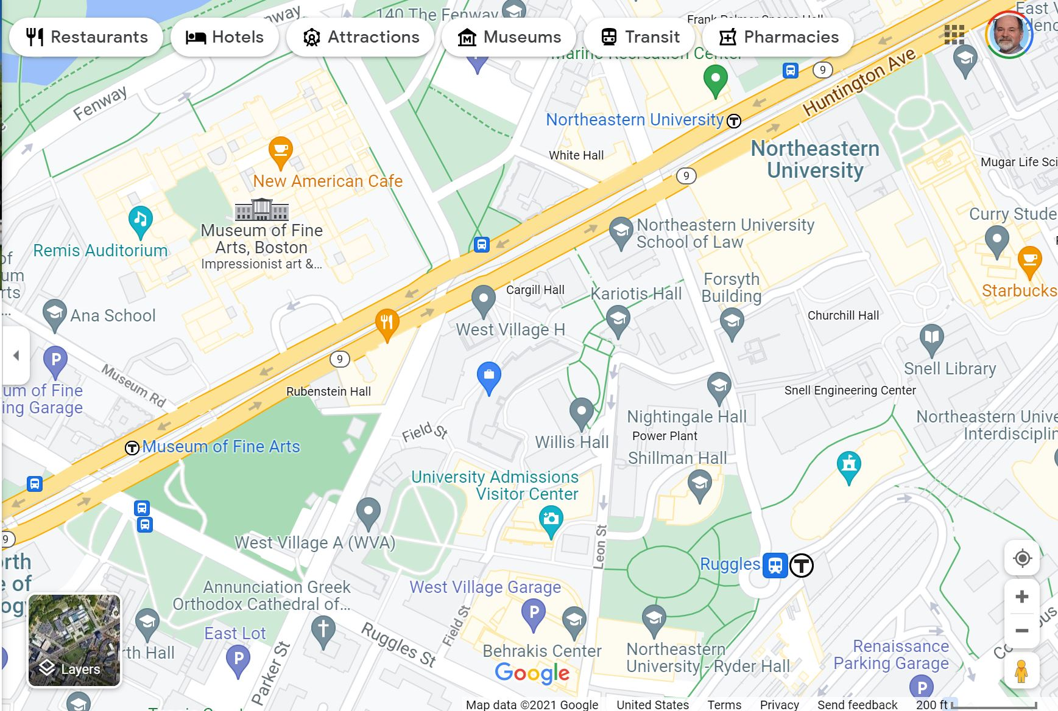
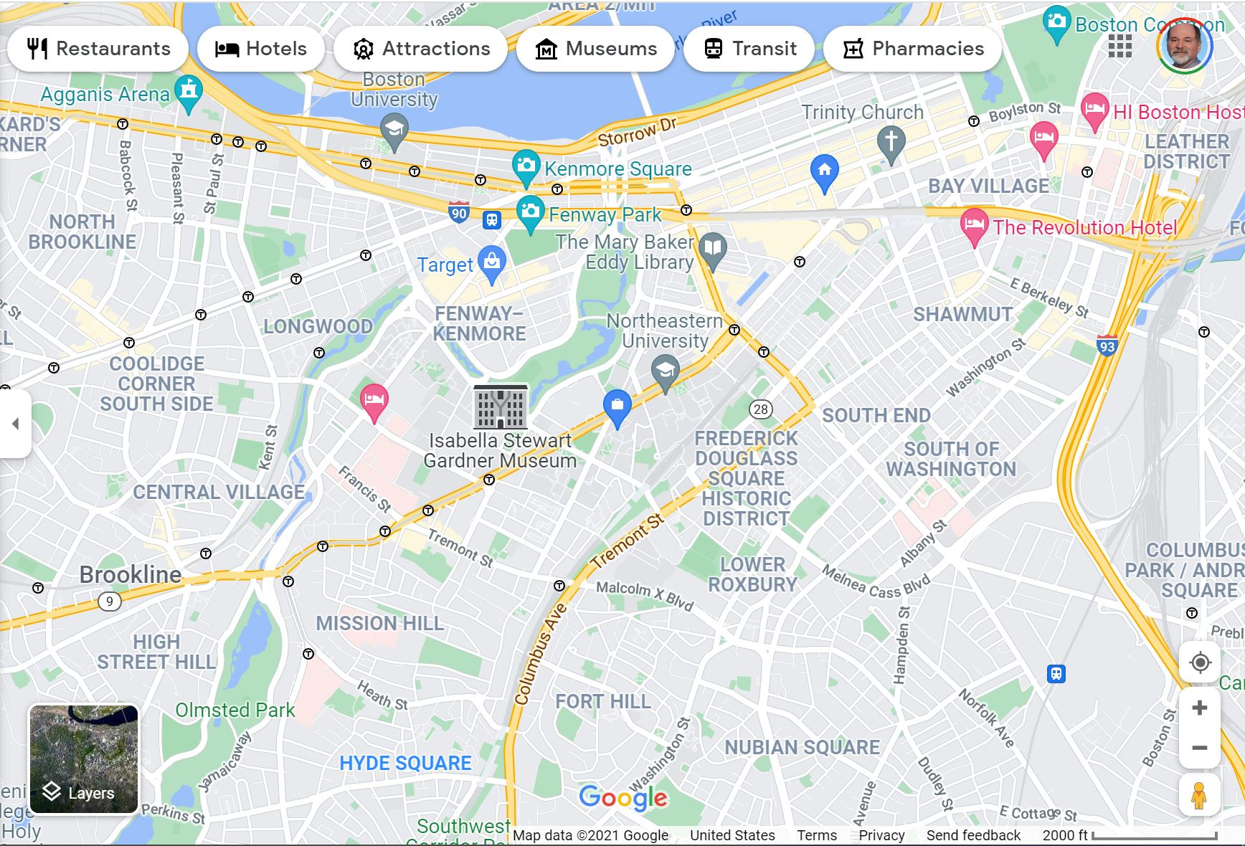
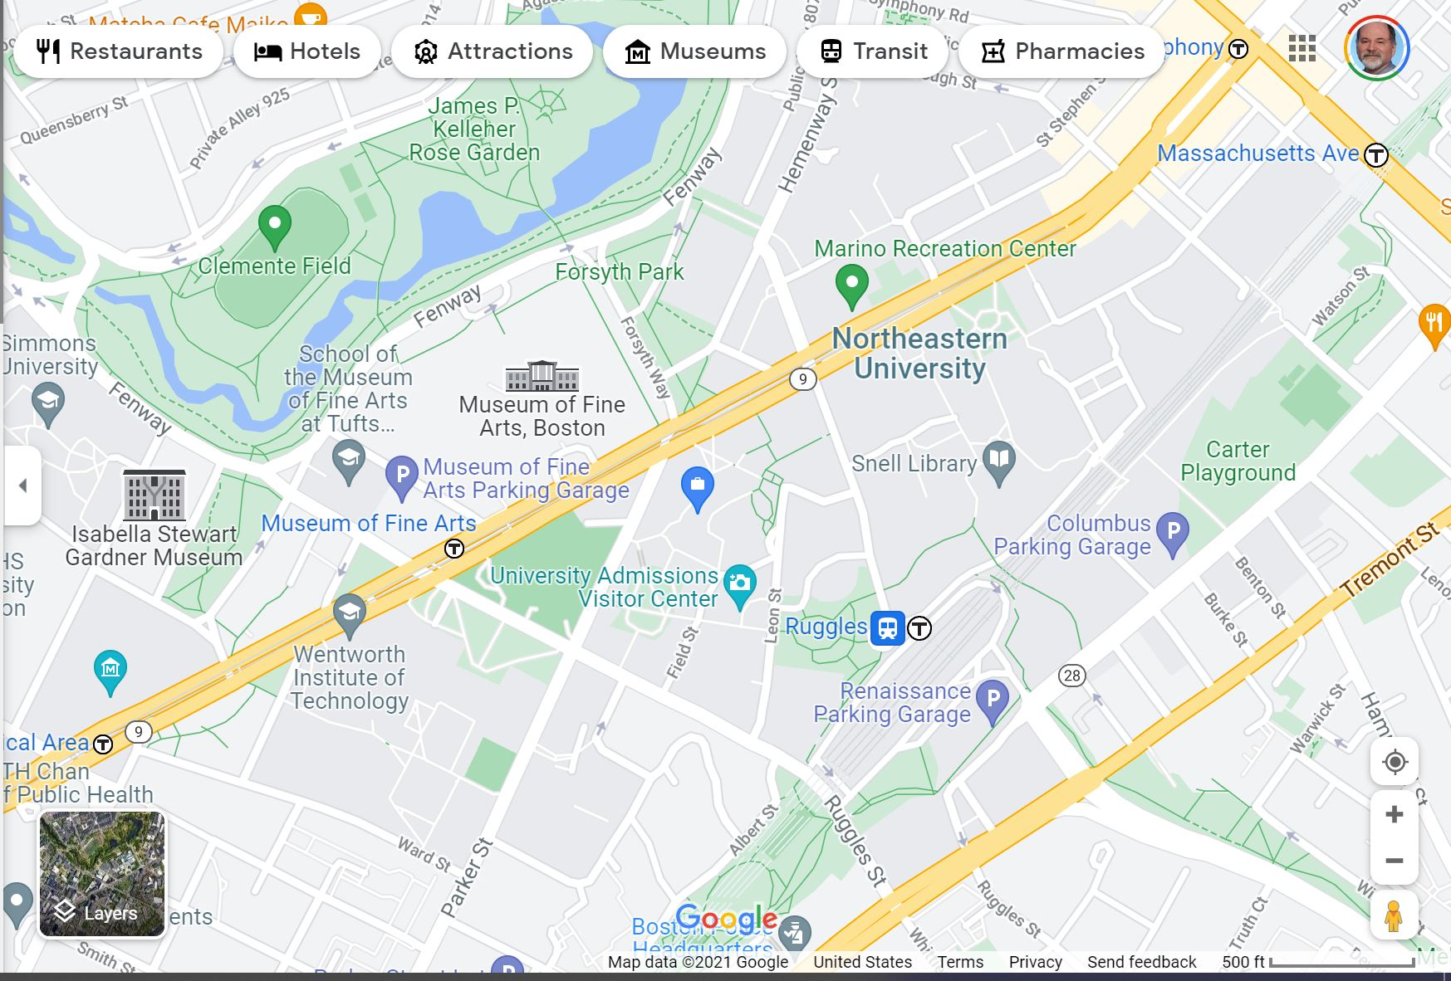
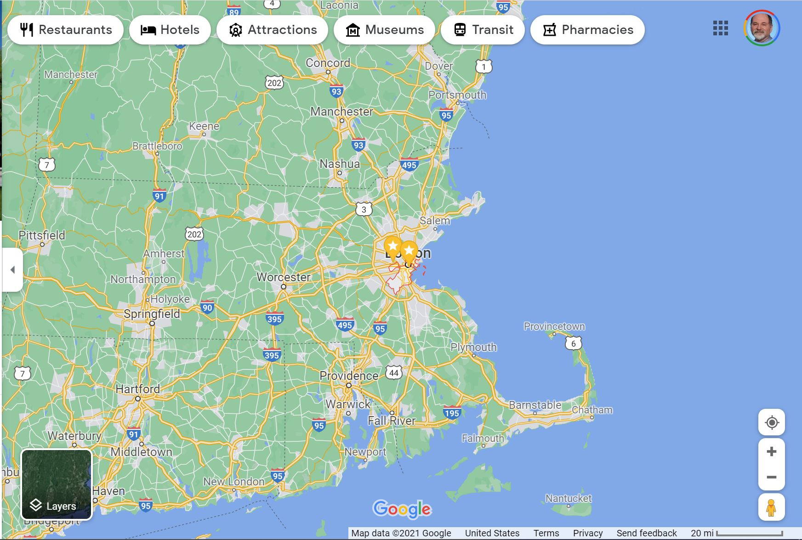
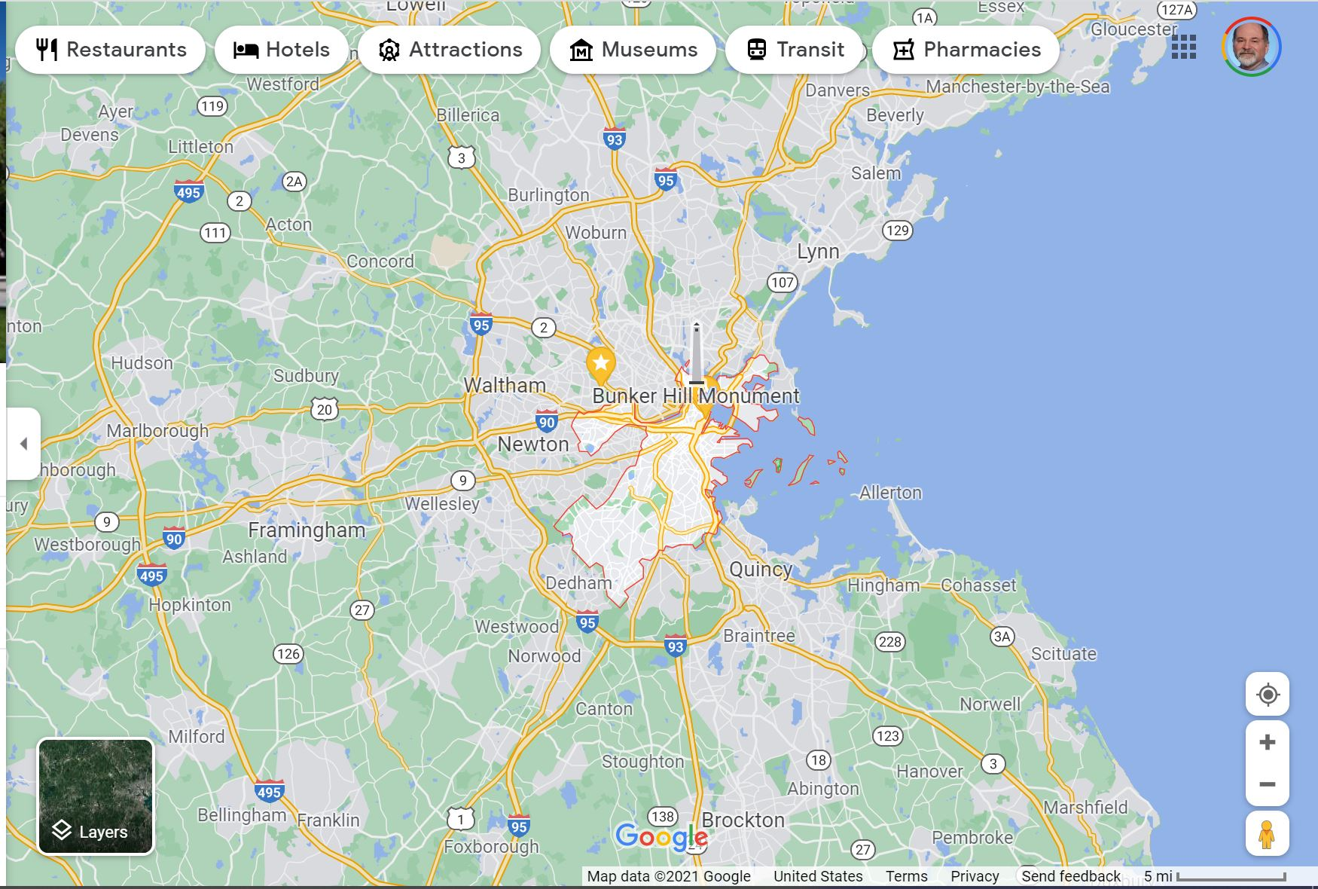
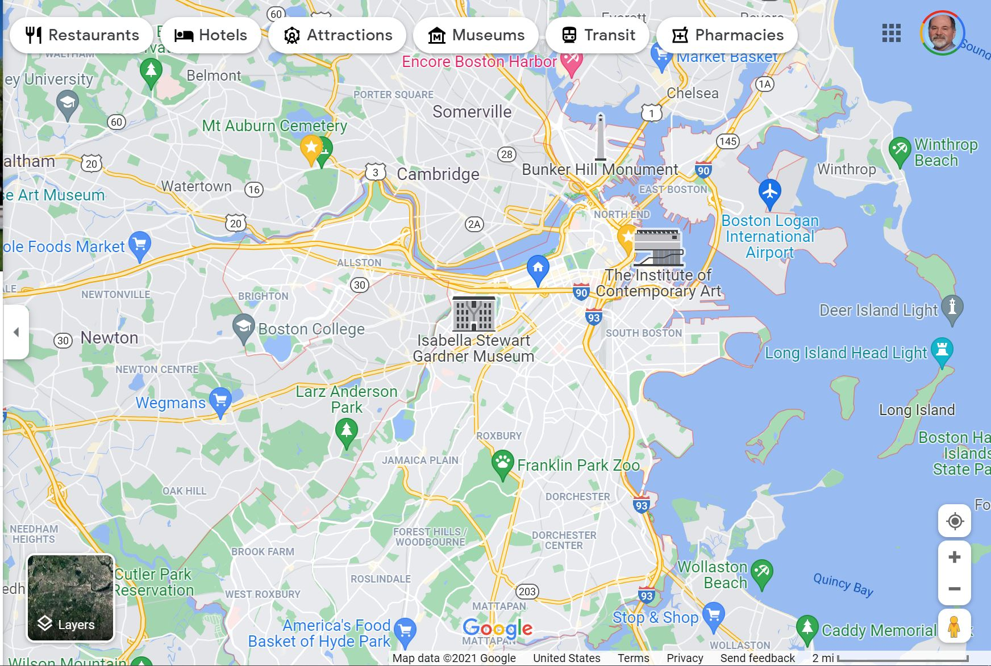
A Design is Less Than the Code
An explanation is always a map of the code
Just like a map, it may have more detail or less, depending on the audience and the goal
Notes:
An explanation is a kind of map of the code. Just like a map, it may have more detail or less detail, depending on the audience and the goal.
<click and watch animation>

Slide 9
Three Scales for Design
The Architectural Scale
key questions: what are the pieces? how do they fit together to form a coherent whole?
The Interaction Scale
key questions: how do the pieces interact? how are they related?
The Object Scale
key questions: what is in each piece? how does each piece communicate with other pieces?
Notes:
In this lecture, we identify three scales for design: the architectural scale, the interaction scale, and the object scale.
<pause to let them read the slide>

Slide 10

The Architectural Scale
key questions: what are the pieces? how do they fit together to form a coherent whole?
Notes:
At the Architectural Scale, the key questions are
What are the pieces?
How do they fit together to form a coherent whole?

Slide 11
The Architectural Scale: Examples of Architectural Styles
Object-oriented
Layered
Pipeline
Microkernel
Notes:
At the architectural level, we can say that a system has
-- an object-oriented architecture
-- or a layered architecture
-- or a pipeline architecture
-- or a microkernel architecture
These are of course only a few of the possible architectural styles. We’ll talk about each of these in a little more detail in the next Lesson.

Slide 12
The Interaction Scale
Key question: how do the pieces interact?
We have names for some of the possible ways.
A few of them are canonized as "Design Patterns".
But the others are just as valid; we'll call them by names that people are likely to recognize.
Notes:
At the Interaction Scale, the key question is….< read slide>

Slide 13
The Interaction Scale: Examples
Observer Pattern
Factory Pattern
Singleton pattern
Notes:
Examples at the interaction scale include the observer pattern, the factory pattern, and the singleton pattern. We’ll talk about each of these in more detail in Lesson 2.3.

Slide 14
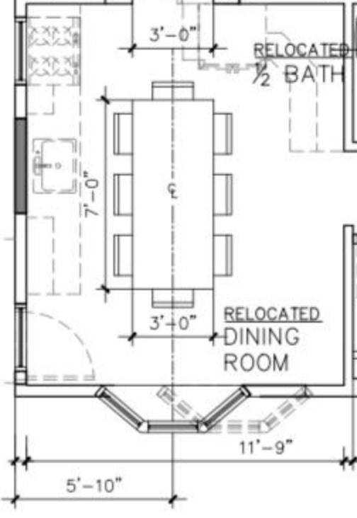
The Object Scale
key questions: what is in each piece? What names does each piece use to communicate the with other pieces?
An abstraction of the actual code (vs of the world)
Choose what details to include
Languages for recording object-scale design
UML diagrams
CRC cards
Javadoc, etc.
Notes:
At the Object Scale, the key questions are: what is in each piece? What names does each piece of the program use to communicate with other pieces of the program?
As before, we get to choose which details to record.
Languages for recording object-scale design include UML diagrams, CRC cards, and Javadoc or JSDoc.
We’ll talk about UML and a little about JSDoc in Lesson 2.4.

Slide 15
Learning Goals for this Lesson
At the end of this lesson, you should be able to
explain why design is important
identify three different scales of design
for each of the scales:
be able to give examples of vocabulary words at each scale
Notes:
<read slide>

